Slide 1



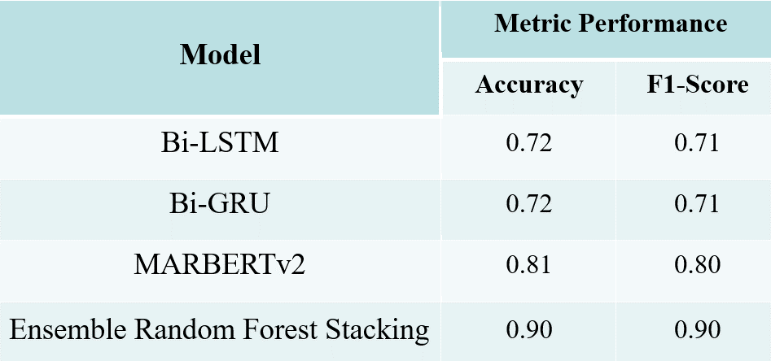
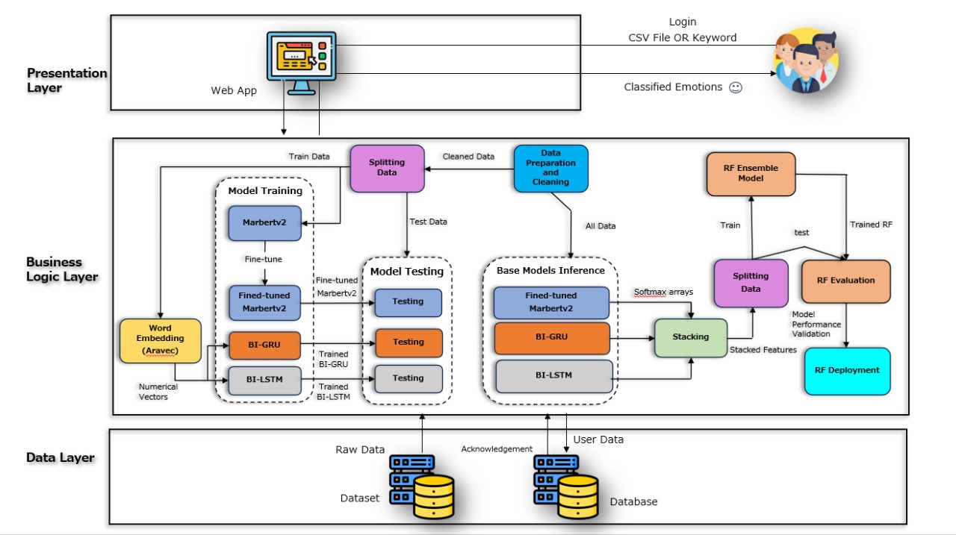
Arabic Sentiment Analysis
By: Ali Abdallah Mohamed, Mohamed Ali Abdelaziz,
Karima Sobhi Abo Al-ala, Ali Maher Talaat, Hany Mohamed Ali,
Abdelrahman Abdelhalim El-Aref
Supervised by: Lecturer. Dr. Shaimaa Haridy , TA. Radwa Mostafa
Faculty of Computer and Information Sciences - Ain Shams University
Introduction
Results
The rapid growth of social media platforms has resulted in an enormous amount of user-generated textual data, offering valuable insights into public emotions and opinions. However, sentiment analysis for the Arabic language remains underdeveloped due to its complex linguistics and diverse dialects.
This study aims to bridge this gap by presenting a novel approach to Arabic sentiment analysis through an ensemble deep learning model. By leveraging Bidirectional Long Short-Term Memory (Bi-LSTM), Bidirectional Gated Recurrent Unit (Bi-GRU), and the MARBERTv2 transformer model combined with Random Forest stacking, our research achieves significant improvements in emotion detection accuracy.
This novel ensemble approach, tested on the Emotone_ar dataset, not only enhances the accuracy and reliability of sentiment analysis in Arabic texts but also provides a practical tool for real-time emotion detection in social media, addressing a critical need in natural language processing for the Arabic language.
Figure 2: Arabic Culture
Methods
Performance Metrics:
The ensemble model achieves an accuracy of 90%, a recall of 90%, and an F1 score of 91%.
1- Dataset Description:
We worked on 'Emotone_ar' dataset which consists of 10,065 Arabic tweets annotated with eight emotions, created by Nile University researchers in Egypt. It features a balanced representation of emotions and covers various Arabic dialects, making it ideal for training and evaluation.
2- System Architecture
  2.1 presentation layer
    User Interaction: Web application interface.
    Login: Users log in to access features.
    Data Input: Upload CSV files or input keywords to classify emotions.
    Display: Results displayed on an interactive dashboard with charts, graphs, and tables.
  2.2. Business Logic Layer
    Data Preparation and Cleaning:
      Remove emails, URLs, mentions, punctuations, diacritics, repeating characters, newlines, stop words, English characters and digits.
      Normalize words.
      Replace emojis and hashtags to words.
    Word Embedding: Uses AraVec to convert raw text into numerical vectors.
    Model Training: Trains MARBERTv2, Bi-GRU, and Bi-LSTM models.
    Model Testing: Evaluates model performance.
    Base Models Inference: Generates SoftMax arrays from trained models.
    Stacking: Combines model outputs to create a feature set for the Random Forest (RF) ensemble model.
    Random Forest Ensemble Model: Trains and evaluates the ensemble model for real-time emotion classification.
  2.3. Data Layer Dataset Management:
    Contains raw data, which is cleaned and split into training (80%), validation (10%), and testing (10%) sets.
3. Workflow
  Data Input: Users log in and provide data (CSV files or keywords).
  Data Preparation: Data undergoes preprocessing and cleaning.
  Model Training and Testing: MARBERTv2, Bi-GRU, and Bi-LSTM models are trained and tested.
  Model Inference and Stacking: Outputs from individual models are stacked.
  Ensemble Model: The Random Forest model classifies emotions and returns results to the user.
Below is a diagram representing the proposed system:
Table 1: Results of used Models
Developing a web application that have:
Batch Analysis: Users can upload CSV files for batch processing, where the system analyses each text entry for sentiment.
Real-Time Analysis: Users can input keywords to fetch and analyse tweets from Twitter in real-time.
Dashboard: The interactive dashboard displays sentiment distribution, detailed analytics, and allows users to download reports in various CSV format.
Conclusions
Our In this study, we developed a web application for Arabic sentiment analysis, achieving significant advancements in natural language processing (NLP) tailored to Arabic text. By employing sophisticated models such as Bidirectional Gated Recurrent Units (Bi-GRU), Bidirectional Long Short-Term Memory (Bi-LSTM), MARBERT, and Random Forest in a stacking ensemble approach, we achieved a high accuracy rate of 90%. This demonstrates the efficacy of our methodology in accurately detecting and classifying a wide range of emotions, including love, anger, fear, and more.
Our application is designed with user convenience and versatility in mind, offering two primary functionalities. Users can upload Excel sheets containing textual data for comprehensive analysis, complete with a detailed dashboard and an option to download the enriched dataset with emotion classifications. Additionally, users can search for specific keywords to retrieve and analyse the latest 50 tweets from Twitter, providing real-time insights into public sentiment. The resulting dashboards present a clear and intuitive
visualization of the sentiment distribution, enhancing data interpretation and utilization.
Bibliography
Alaa Mansy, Sherine Rady, and Tarek Gharib. "An ensemble deep learning approach for emotion detection in arabic tweets." International Journal of Advanced Computer Science and Applications 13.4 (2022).
N. Alswaidan and M. E. B. Menai, "Hybrid Feature Model for Emotion Recognition in Arabic Text," IEEE Access, vol. 8, pp. 37843-37854, 2020, doi: 10.1109/ACCESS.2020.2975906.
H. Elfaik and E. H. Nfaoui, "Combining Context-Aware Embeddings and an Attentional Deep Learning Model for Arabic Affect Analysis on Twitter," IEEE Access, vol. 9, pp. 111214-111230, 2021, doi: 10.1109/ACCESS.2021.3102087.
Figure 1 System Architecture

